Slide 1








ANALYZING DIABETES DATASET
27-12-2024
DSAI (307) Statical Inference

Slide 2

Contents
Dataset Structure
2. Preprocessing
3. Exploratory Analysis
4. Question
5. Hypothesis Testing
6. Simulation

Slide 3
Dataset Structure
The The diabetes dataset comprises various health metrics from individuals, designed to explore potential risk factors for diabetes. This comprehensive dataset includes both biometric and clinical data points.
It consists of 768 records of female patients, each characterized by 8 health-related attributes. The Outcome variable indicates whether the patient has diabetes (1) or not (0).

Slide 4
Dataset Structure
Dataset Columns:
Pregnancies: Number of times the patient has been pregnant.
Glucose: Plasma glucose concentration after a 2-hour oral glucose tolerance test.
BloodPressure: Diastolic blood pressure (mm Hg).
SkinThickness: Triceps skinfold thickness (mm).
Insulin: 2-hour serum insulin (mu U/ml).
BMI: Body mass index (weight in kg/(height in m)^2).
DiabetesPedigreeFunction: A function that represents the patient’s diabetes pedigree (i.e., likelihood of diabetes based on family history).
Age: Age of the patient (years).
Outcome: Binary outcome (0 or 1) where 1 indicates the presence of diabetes and 0 indicates the absence.

Slide 5
2. Preprocessing
In the preprocessing, there were some outliers, which were replaced with boundary values determined by the Interquartile Range (IQR) method to minimize their effect on the analysis. This approach ensures the robustness of our findings by maintaining the integrity of the data distribution while reducing the impact of extreme values.
There also were no Duplicates or Nulls

Slide 6
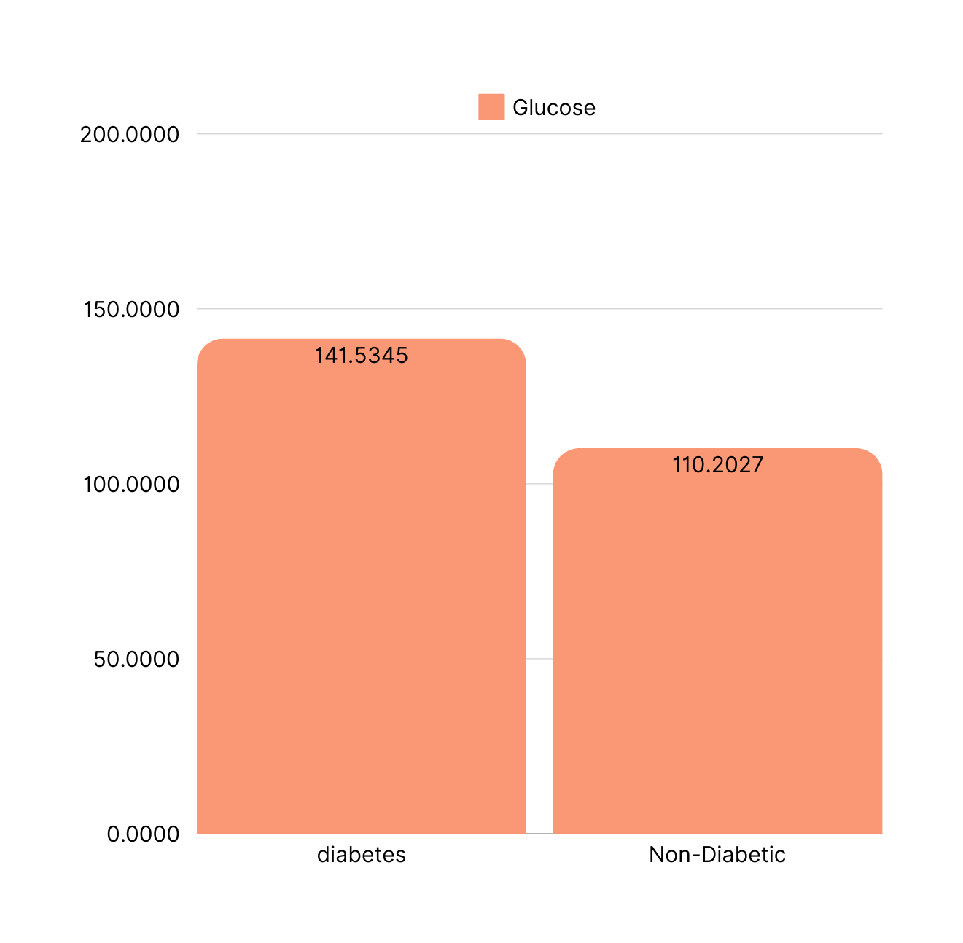
3. Exploratory Analysis
In this phase, we explored the data by answering some questions, The average glucose levels among patients with and without diabetes?

Slide 7
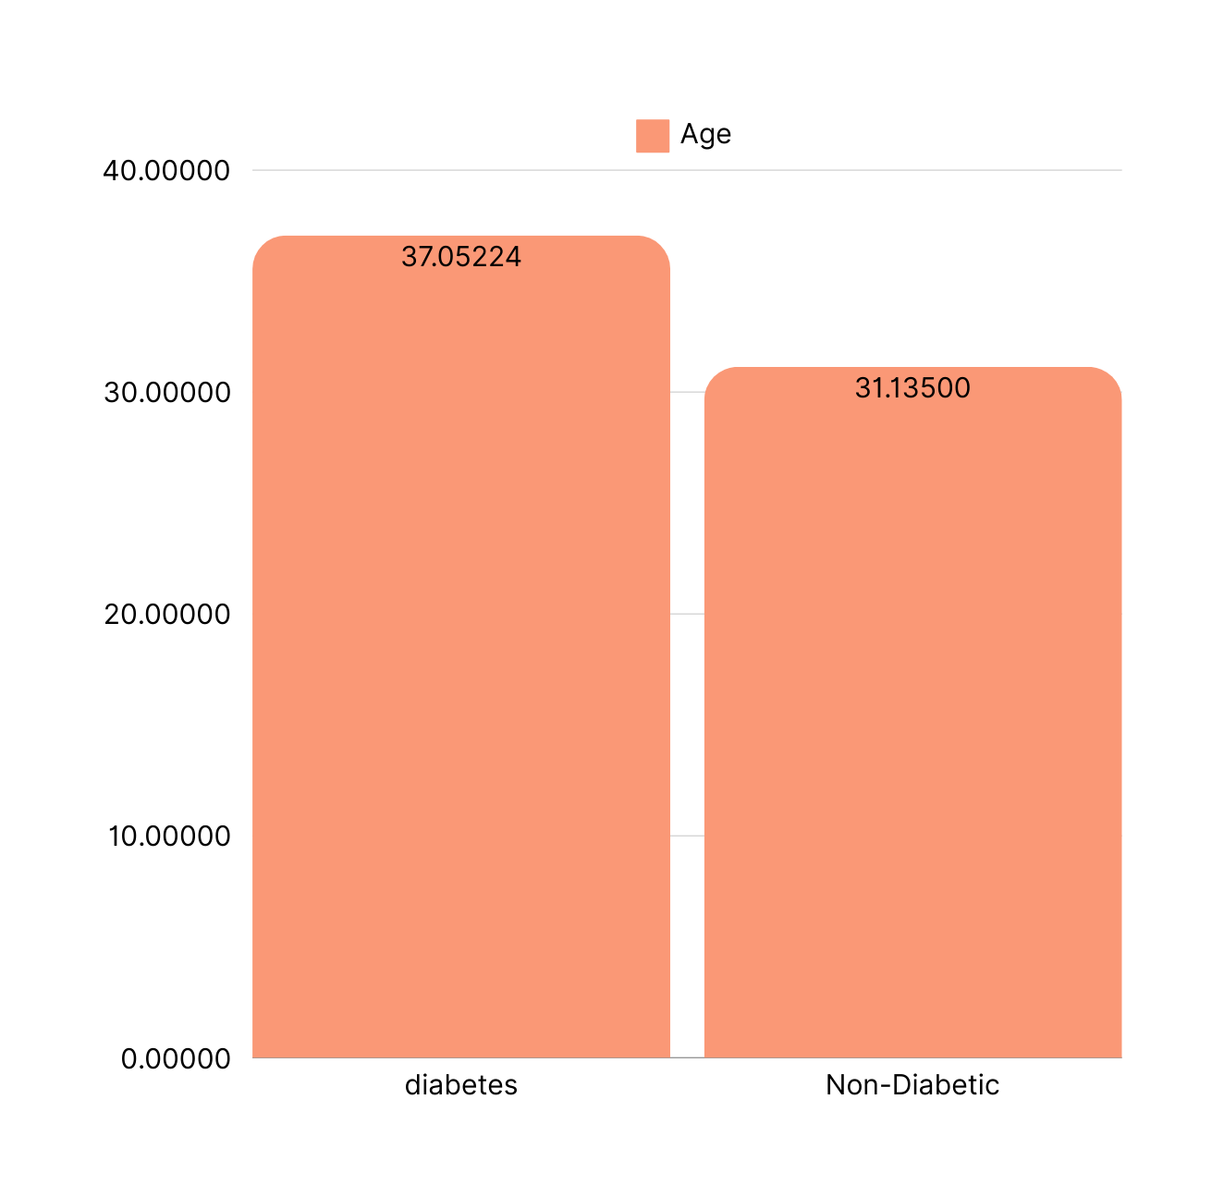
3. Exploratory Analysis
2nd Question:
The graph shows the average age of patients with and without diabetes.

Slide 8
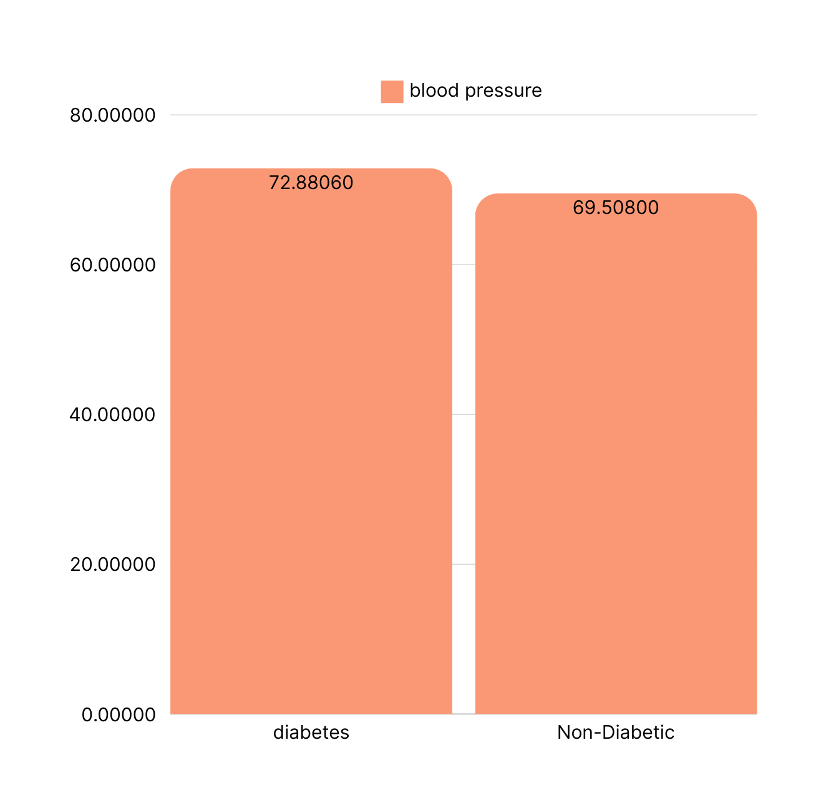
3. Exploratory Analysis
3rd Question:
The graph shows the average blood pressure measurements across diabetic and non-diabetic groups.

Slide 9
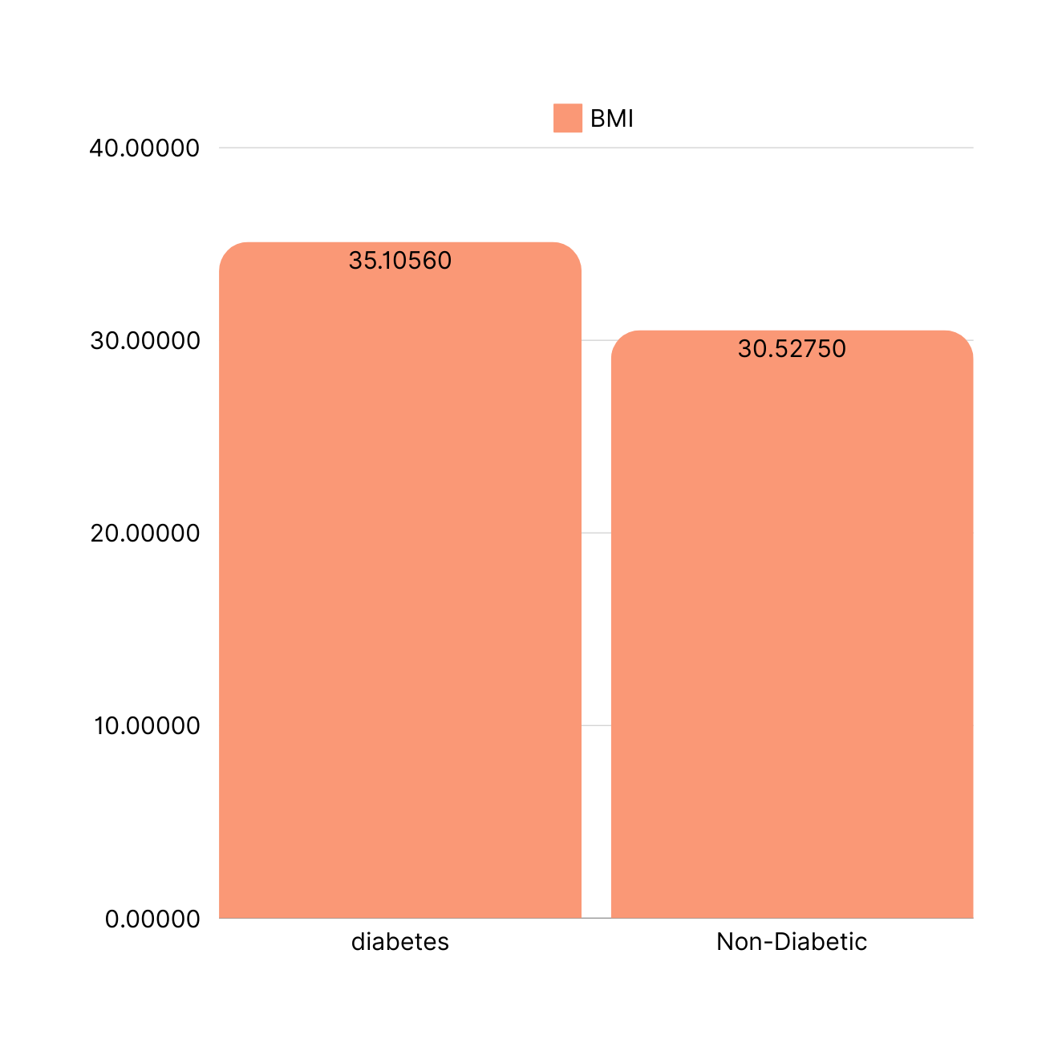
3. Exploratory Analysis
4th Question:
The graph shows the average BMI of diabetic versus non-diabetic patients.

Slide 10
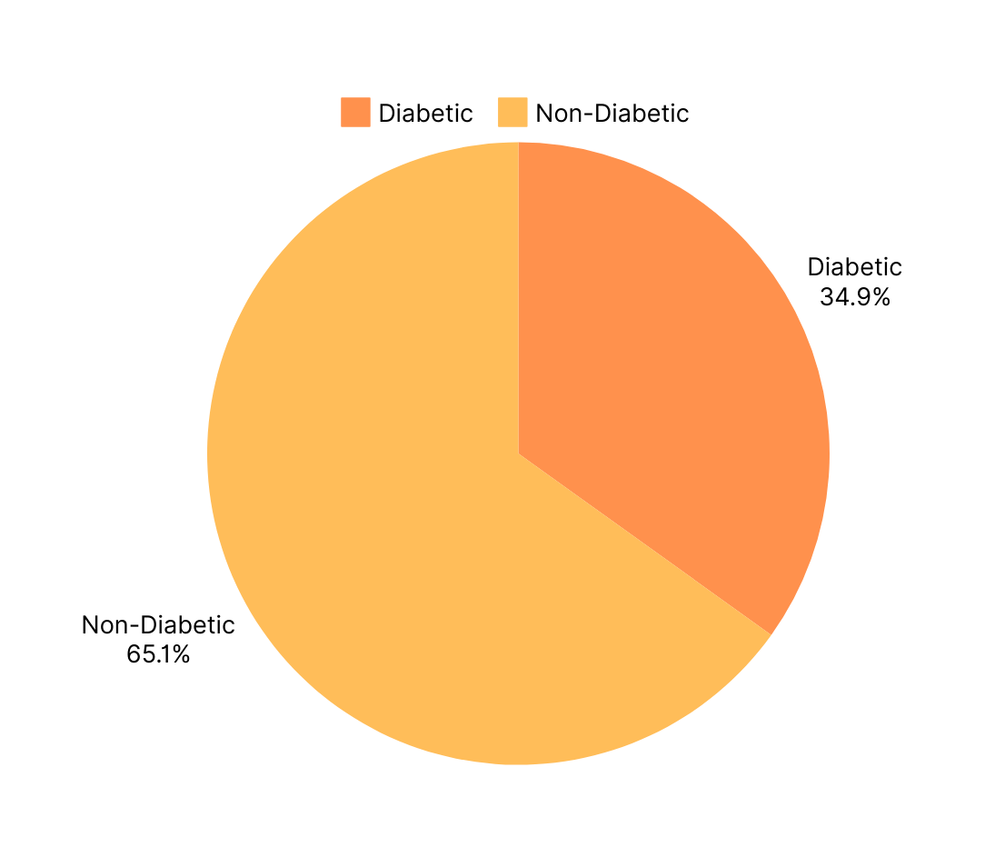
Approximately 0.34895834% of patients are diabetic.
3. Exploratory Analysis
5th Question:
The graph shows the rate of diabetes among patients in the dataset

Slide 11
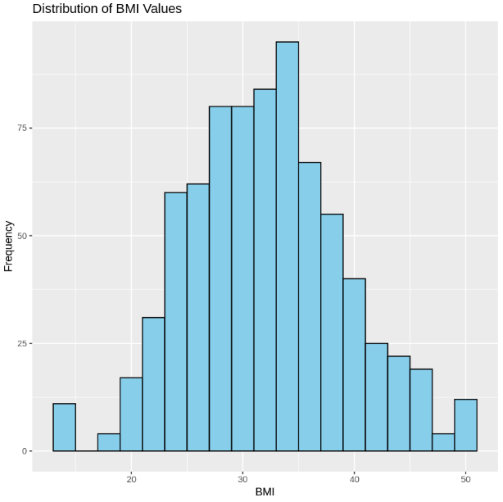
3. Exploratory Analysis
6th Question:
The Graph Show The distribution of BMI values among all patients

Slide 12
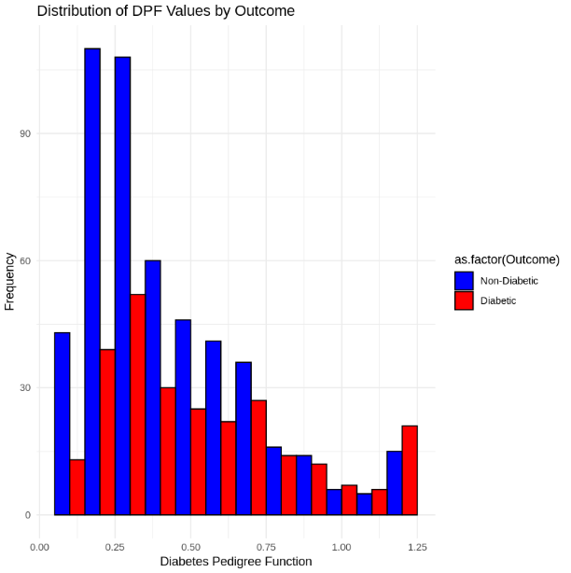
3. Exploratory Analysis
7th Question:
The graph shows the distribution of Diabetes Pedigree Function (DPF) values for diabetic and non-diabetic patients

Slide 13
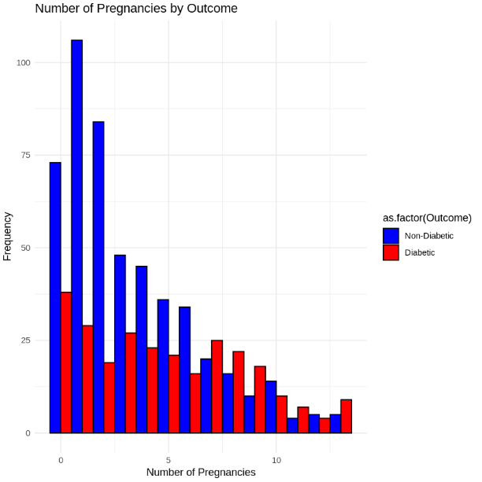
3. Exploratory Analysis
8th Question:
The graph shows the relationship between the number of pregnancies and diabetes occurrence.

Slide 14
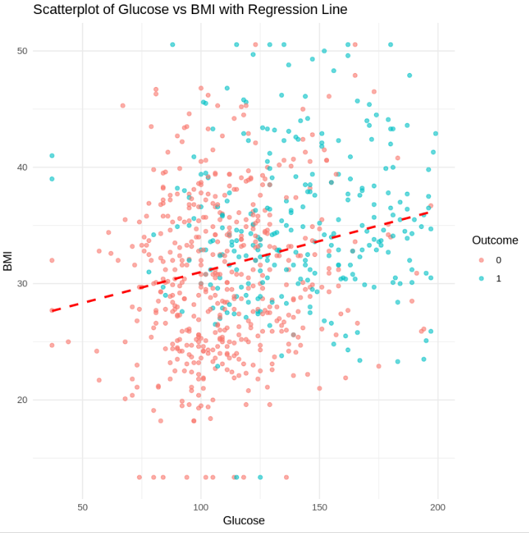
3. Exploratory Analysis
9th Question:
This scatter plot shows the correlation between glucose levels and BMI

Slide 15
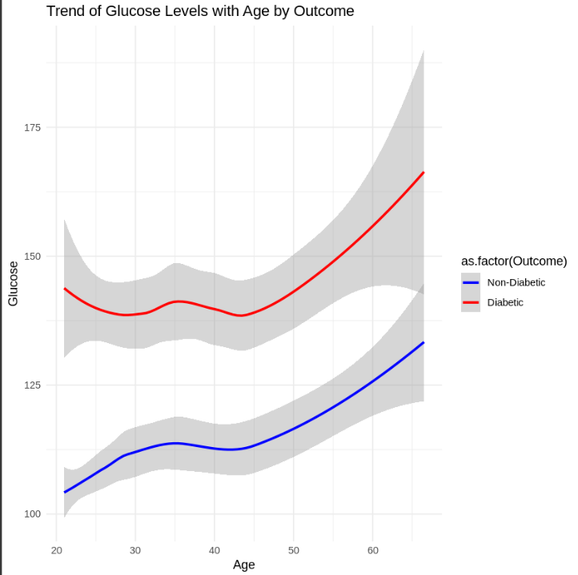
3. Exploratory Analysis
10th Question:
The trend of glucose levels with age among diabetic and non-diabetic patients

Slide 16
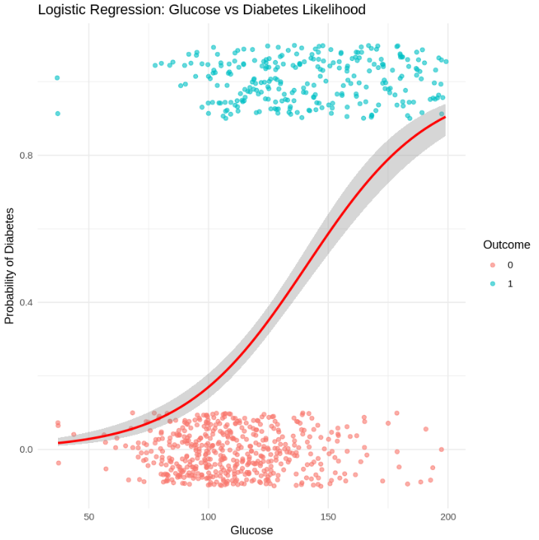
3. Questions
In this phase we answer some questions using different types of Graphs.
Are higher glucose levels associated with a greater likelihood of diabetes?

Slide 17
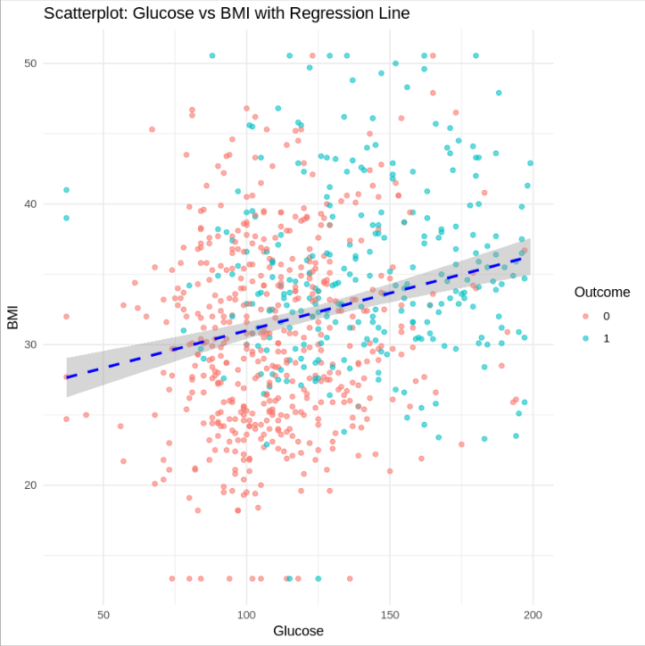
3. Questions
Are patients with high glucose concentrations also likely to have higher BMI values?

Slide 18
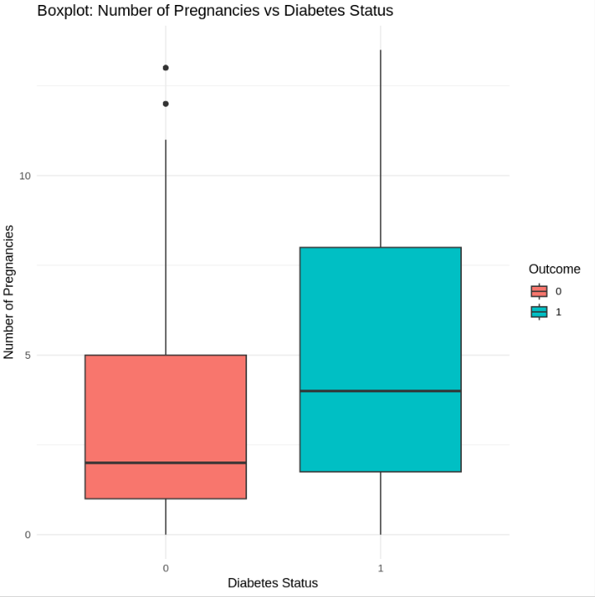
3. Questions
Are patients with a higher number of pregnancies at greater risk of developing diabetes?

Slide 19
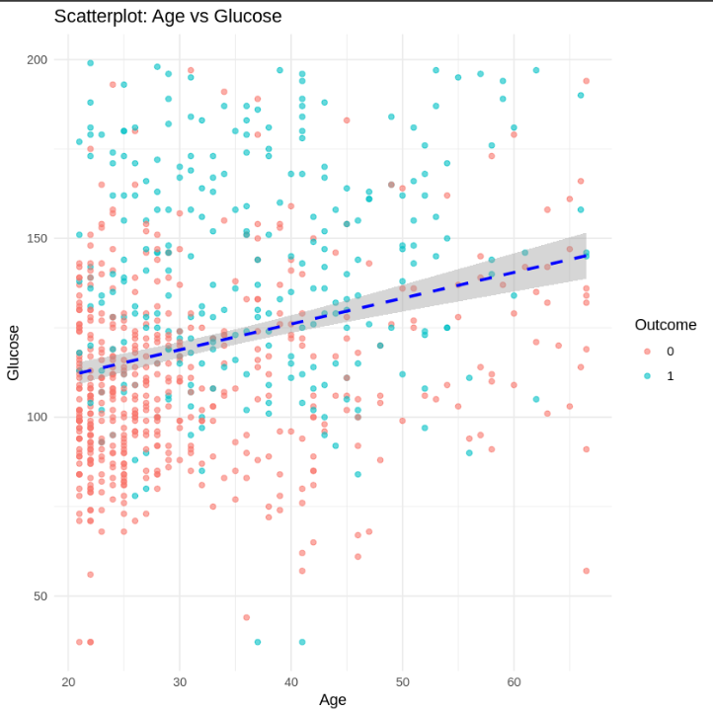
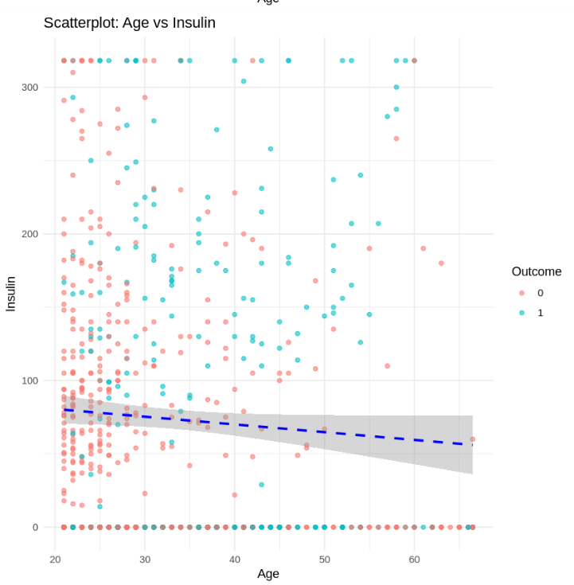
3. Questions
Are older patients more likely to have higher insulin concentrations and blood glucose levels?

Slide 20
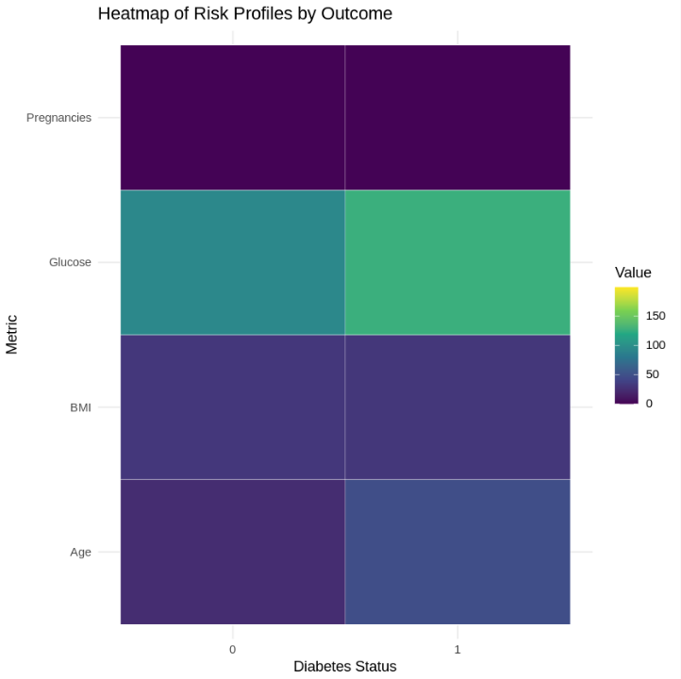
3. Questions
Can you identify common “risk profiles” for diabetic patients based on key metrics (glucose, BMI, age, etc.)?

Slide 21
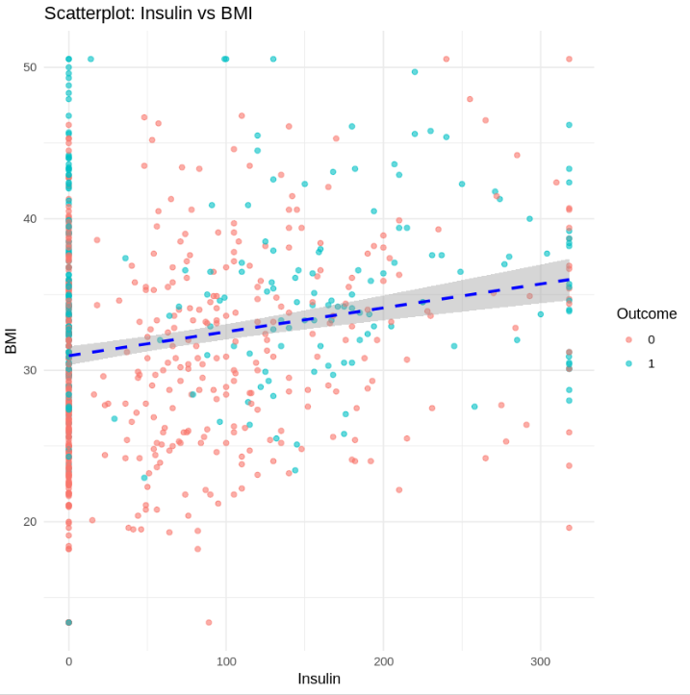
3. Other Questions
Is there a relationship between insulin levels and BMI?

Slide 22
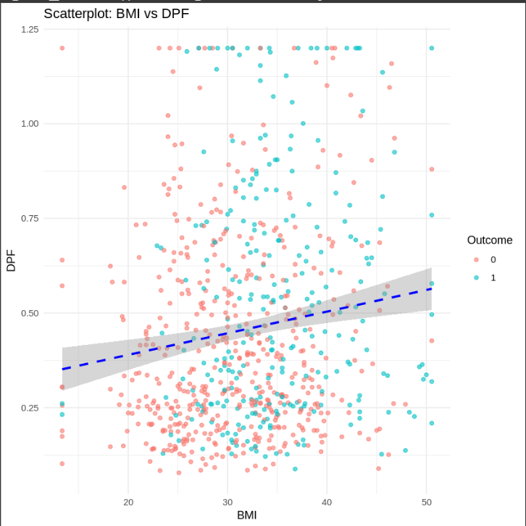
3. Other Questions
Are patients with higher BMI also more likely to have a higher diabetes pedigree function?

Slide 23
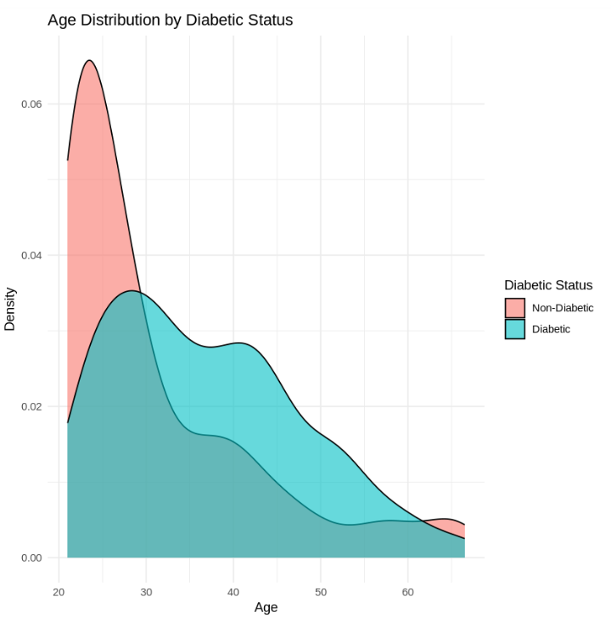
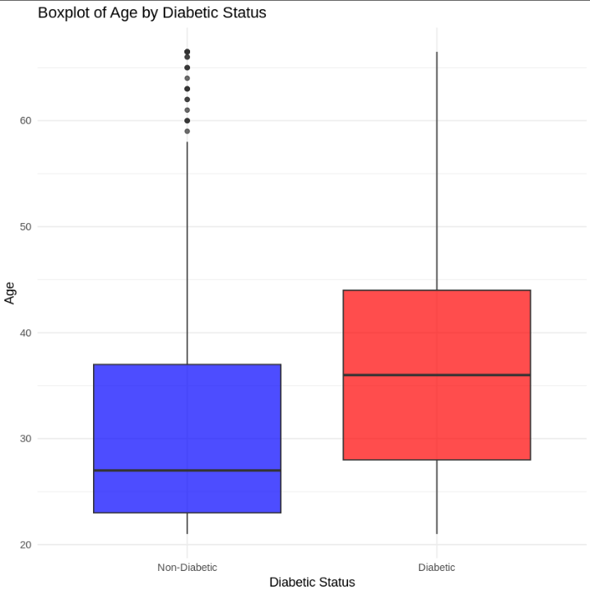
3. Other Questions
How does the age distribution differ between diabetic and non-diabetic patients?

Slide 24
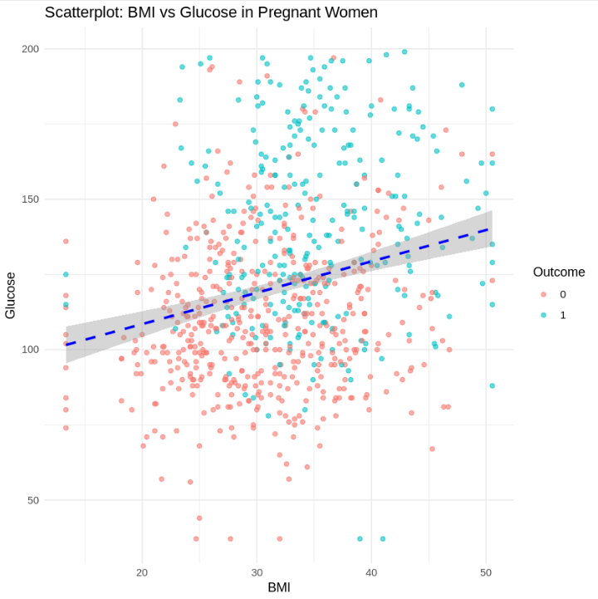
3. Other Questions
Do pregnant women with a higher BMI tend to have higher glucose levels?

Slide 25
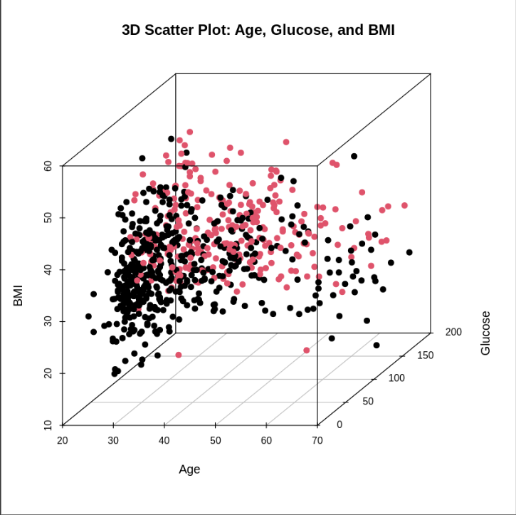
3. Other Questions
Can age, glucose, and BMI together predict the likelihood of diabetes?

Slide 26
4. Hypothesis Testing
In the Hypothesis testing, we did 2 tests
Claim 1: “There is a significant difference in glucose levels between diabetic and non-diabetic patients.”
Claim 2: "There is a significant difference in insulin level between diabetic and non-diabetic patients."

Slide 27
5. Simulation
We explored the behavior of the confidence intervals for the BMI column with different scenarios, for each one we:
Calculated the population mean of the BMI column.
Generated random samples with different sizes.
For each sample: Calculated the sample mean and standard error (SE), calculated the 95% confidence interval using the t-distribution, and checked if the interval contained the true population mean.
Calculated the proportion of intervals that included the true mean.
1. Take 25 random samples of size 15 from the dataset.
The result was that the proportion of intervals containing the true mean was 0.96 (96%).
2. Increase the sample size to 100.
The result was that the proportion of intervals containing the true mean was 1.0 (100%), and the average width of confidence intervals was 2.75.
3. Take 20 Random Samples of Size 10 from the Dataset
The result was that the proportion of intervals containing the true mean was 0.95 (95%).

Slide 28
Thank You

